Slide 1
Computerized Dance Classroom
Using kinect to evaluate dance performances
Stylianos venieris
Marcin baginski
Theo pavlakou
Hesam ipakchi
Zeping xue
Yijie ge
Notes:
Marcin

Slide 2
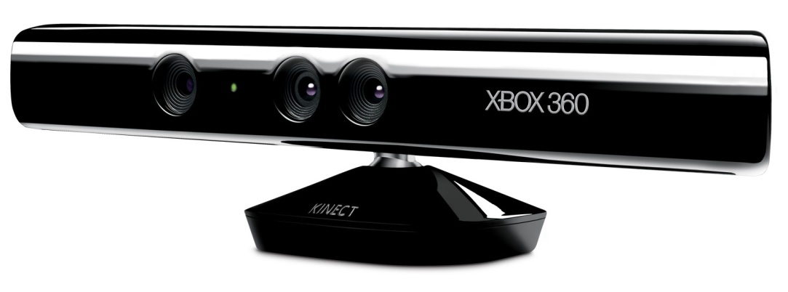


Project Background
RGB-D cameras:
Microsoft Kinect
Asus Xtion
other
OpenNI
NiTE
Notes:
Marcin: An emergence of affordable RGB-D cameras, such as Microsoft Kinect or Asus Xtion, has lead a development of applications with a completely new type of user interaction, called the natural interface. With an RGB-D camera, users are not required to hold any controllers in their hands, but instead perform gestures in front of the camera, which are automatically interpreted by the device. This gestures are recognised due to the camera’s ability to capture the depth stream, in addition to the traditional color stream, which allows to create an essentially 3D picture inside the camera.
RGB-D cameras, together with open source frameworks for programming them, such as OpenNI and NiTE, opened doors for many custom applications based on this technology. OpenNI is a Software Development Kit which allows to communicate with the camera and access the data captured by it, while NiTE is a set of classes to fit a human skeleton to the video stream from Kinect.

Slide 3
Project Aims
Bring Kinect technology to a dance classroom
Evaluate tracking capabilities of Kinect, OpenNI and NiTE
Develop software for recording dance performances
Create algorithms for automatic recognition of errors and comparison of two dance movements
Make the application user friendly
Notes:
Marcin: The main aim of our project was to bring Kinect technology to a dance classroom. In order to make this possible, initially we needed to evaluate the tracking capabilities of both the hardware and the corresponding software. This was essential, in order to identify how robust the technology is, and what features are feasible to be implemented.
After evaluation, the focus was to develop a software for recording and replaying the dancing. However, the core of the project lies in the algorithms for automatic comparison of two dance performances.

Slide 4
Outline
Evaluation of Kinect, OpenNI and NiTE
Automatic Scoring System
Motionless Activity Detector
Translation Module
Data Alignment Module
Data Analysis Module
Application and its features
Extensions and Limitations
Commercial Aspect
Notes:
Marcin: So, in the presentation we are going to briefly describe the results of our evaluation, and then proceed to talking about the automatic scoring system. After that, we will demonstrate the prototype application and what it can currently do. We will also describe the extensions which we have thought of, and the ones which were eventually implemented. At the end, we will talk briefly about the commercial aspect of the entire project.

Slide 5
Evaluation of Kinect, OpenNI and NiTE
Camera range:
60 cm – recognises subjects
120 cm – starts tracking
410 cm – stops tracking
Lighting conditions:
No effect on the tracking capabilities
Velocity of movement
Faster movement can decrease the precision of data returned from NiTE
Camera angle relative to the performers
If a person stands at a 90° to the camera, it can lose tracking of the limbs which are covered by the body
Notes:
Stelios

Slide 6
Evaluation of Kinect, OpenNI and NiTE
Interference between multiple cameras
Careful placement of cameras can minimise the interference
Occlusion in front of the camera
Creates a problem, camera loses tracking if a part of the body is covered by an object
Number of tracked people
In theory constrained only by how many can actually fit in the camera range
In practise, inevitable occlusion between multiple people limits the number to about 2
Notes:
Stelios

Slide 7
Automatic Dance Scoring - System
Motionless Activity Detector
Translation Module
Score
Data Alignment Module
Data Analysis Module
Dance
Main purpose of the system – compare and score the student’s performance with respect to the teacher’s
Divided into four manageable modules, where the output of the former is the input of the latter
Notes:
Theo

Slide 8
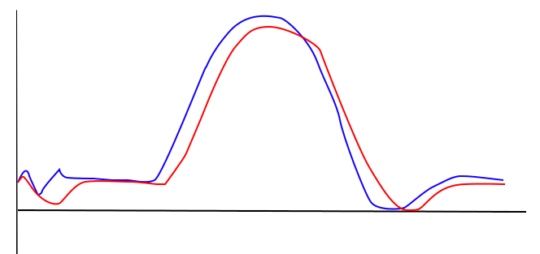
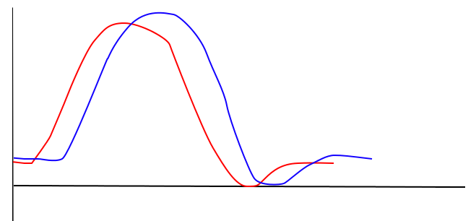
Automatic Dance Scoring – Motionless Activity Detector
Motionless Activity Detector
Before performing any movement, the person needs to stand still for approx. 2 s for the software to calibrate
Motionless Activity Detector returns a frame number in the recording where the person was not moving
Input
Output
Notes:
Theo

Slide 9
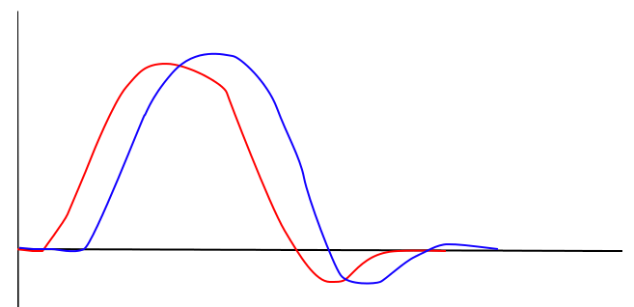
Automatic Dance Scoring – Translation Module
Translation Module
Takes the frame number from the Motionless Activity Detector and discards all the data which happened before this frame
Additionally, ‘normalises’ the data, such that the exact position of the subject in the camera range not included any more
Input
Output

Slide 10
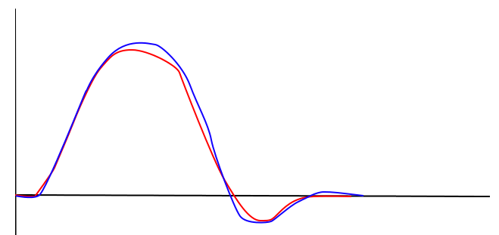
Automatic Dance Scoring – Data Alignment Module
Data Alignment Module
Even after previous processing, there is still a possibility of misalignment between the data of two dance moves
Data Alignment Module aims to bring the two signals to as close alignment as possible
Input
Output
Notes:
Theo

Slide 11
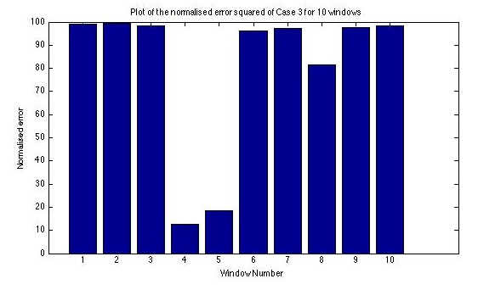
Automatic Dance Scoring – Data Analysis Module
Data Analysis Module
Takes two aligned signals and produces a score as the output
Produces an average score for the entire dance as well as a windowed score for each of the 10 parts of the dance, each of equal duration
The scores are calculated for each coordinate and joint
Input
Output
Notes:
Theo

Slide 12
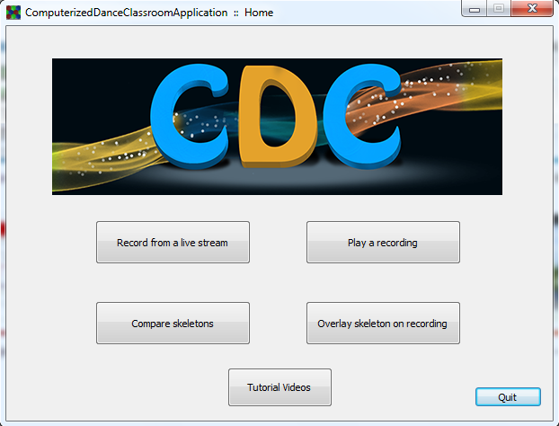
The Application
Notes:
Demo

Slide 13
Extensions
Teacher-defined level of importance for each part of the student’s body during a dance
Already implemented and integrated in the application
Use of a machine learning algorithm to derive a scoring scheme based on dance instructors’ metric
Prototype implemented and tested in Matlab
Use of multiple cameras to improve the overall accuracy
Substantial obstacles due to calibration and tracking overhead
Notes:
Stelios

Slide 14
Limitations
Tracking limitations of Kinect, OpenNI and NiTE
Range, velocity of movement, time for calibration
OpenNI supports only one camera on one computer
Partner dances not supported
Due to inevitable occlusion which distorts the data
Height differences
Significant differences in height increase the error
Specific instructions must be followed by the user
e.g. the dancer needs to stand still for approx. 2 s before dancing
Notes:
Marcin: As with every prototype, there are certain limitations to the current version of the software. The most obvious ones come from the tracking limitations of Kinect, OpenNI and NiTE. The range of the camera is restricted, and the velocity of movement in front of it can make the data reported from Kinect lag behind the movement of the subject. Additionally, a single OpenNI application only supports one camera on one computer, hence it is impossible to use multiple cameras, for improved tracking performance, using only one application and computer.
As mentioned previously, occlusion can significantly distort the data. If Kinect loses track of at least one joint during the performance, the data will be corrupted and useless in the automatic scoring system. Therefore, partner dances, during which occlusion is unavoidable, are not supported.
Also, since the algorithm uses the error squared as a primary metric to score the dance, significant height differences between the teacher and the student can potentially make the error bigger than it theoretically should be. However, in most cases this has been proven not to be a problem.
Finally, specific instructions must be followed by the dancer prior to recording. In particular, the dancer needs to stand still in front of the camera for approximately 2 seconds before performing the dance, in order for the software to identify the beginning of the dance.

Slide 15
Commercial Aspect – solving the problem
Lack of specific feedback for students in large groups
The application provides student-specific feedback and can keep track of the student’s progress
Must travel to a physical destination to practise
The application allows to practise at any time and in any place, therefore beneficial for both students and teachers
Expensive
By increasing the number of students per teacher and decreasing the time that needs to be devoted physically to each student, the application can significantly reduce the cost of learning to dance
Notes:
Theo: Problem definition: teacher – students ratio.
- Approach a ratio of 1
- More accurate student-specific and dance-specific (see weightings) feedback
- Homework
- Possible to revolutionize dance classrooms
Possible extension to online courses (eg online guitar courses)
Automated, reliable marking (trained by professionals)
- Can be extended to other activities (martial arts, aerobics, etc)

Slide 16
Commercial Aspect – business model
Two versions of the software – student and teacher
Teachers have access to a cloud space where they can upload their videos
Students can obtain the dances from the online store where they can choose to download their teacher’s videos or videos uploaded by others for a small fee
The software needs initially 10 people for the development, customer support and maintenance purposes
Notes:
Theo

Slide 17
Conclusion
Available hardware (Kinect) and software (OpenNI, NiTE) can be successfully used, subject to limitations
Algorithm for automatic scoring works well
The prototype application includes:
Recording of dance movements
Playback of the recorded videos
Tracking and overlaying skeletons on each other
Automatically scoring of two dance moves
We believe that the product can be successfully commercialised after beta testing in the real environment
Notes:
Theo

